Slide 1
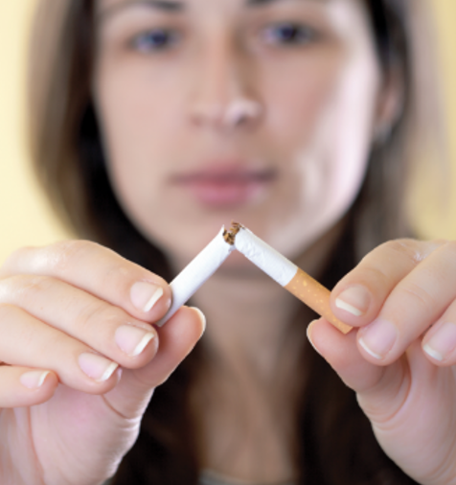

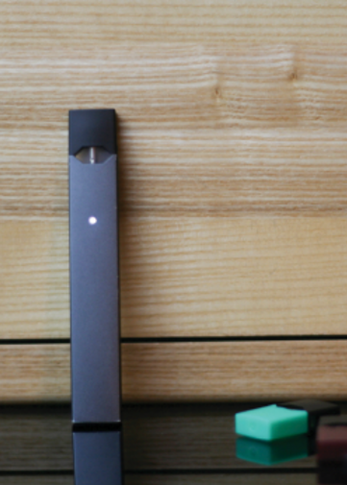
COMMAND INDOCTRINATION
Tobacco Presentation

Slide 2
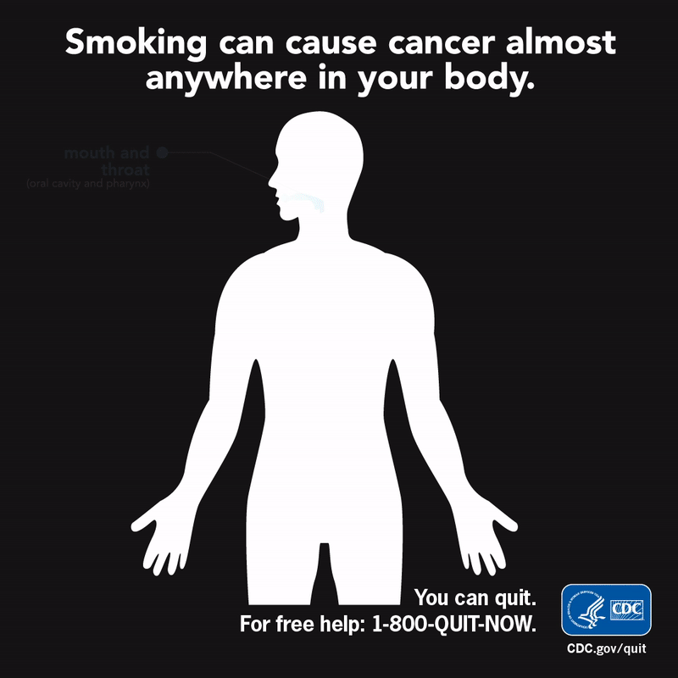
Tobacco Use is Harmful to Your Health
More than 480,000 Americans die every year prematurely due to smoking cigarettes or being exposed to secondhand smoke.
Notes:
For over 50 years, the Surgeon Generals of the United States have told us about the dangers of smoking and using tobacco. If you smoke and use tobacco it harms almost every organ in your body and it will kill you. Every year almost half a million Americans die as a result of smoking and their exposure to second hand smoke. It is the single most preventable cause of death in this country.

Slide 3
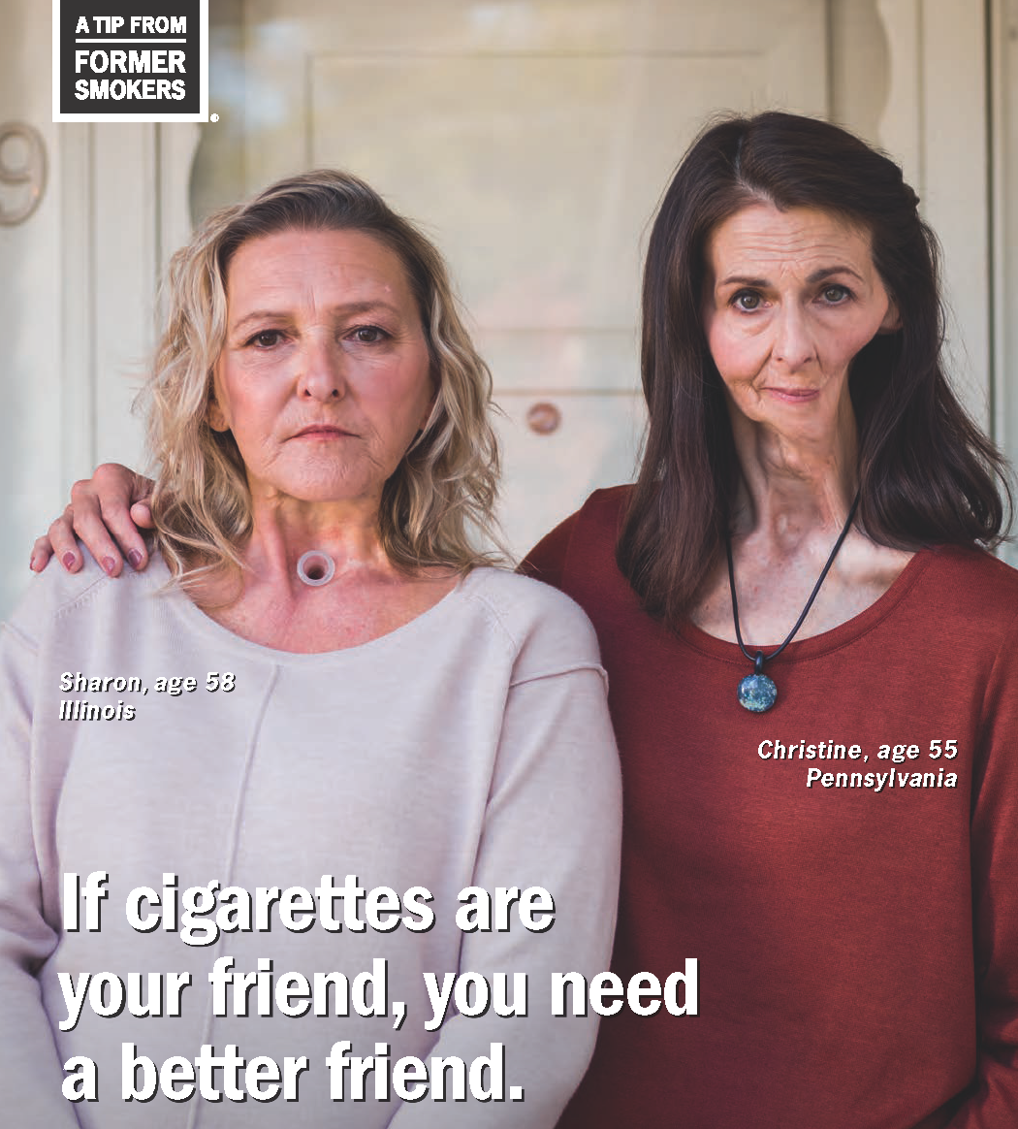
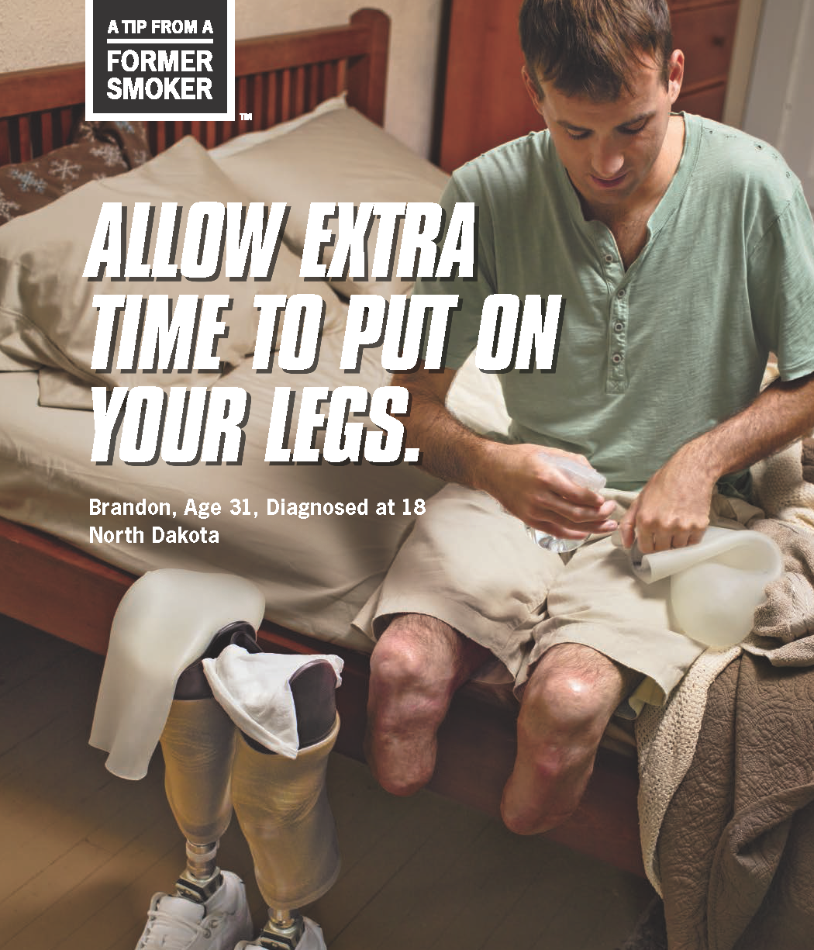
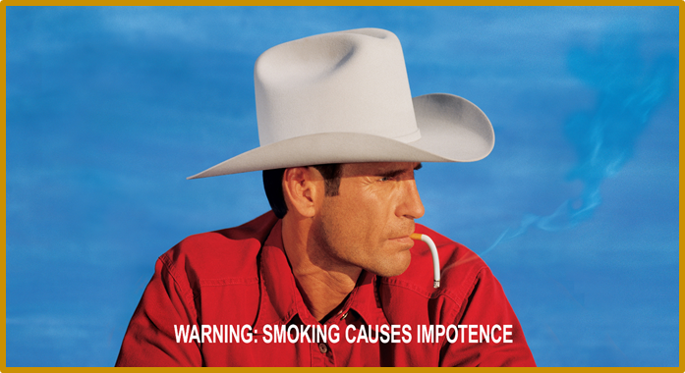
Tobacco Use Is Harmful to your Health

Slide 4
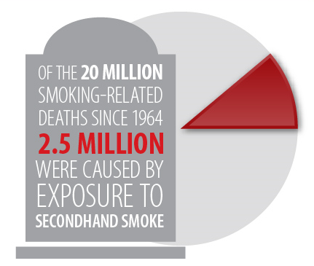
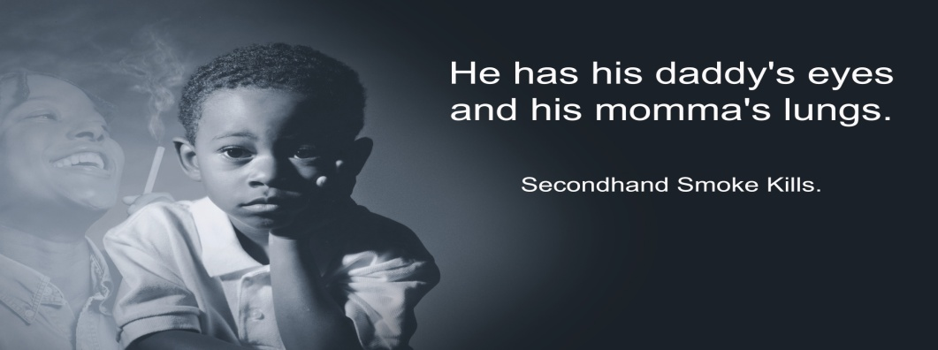
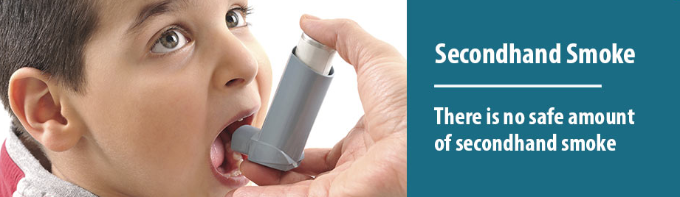
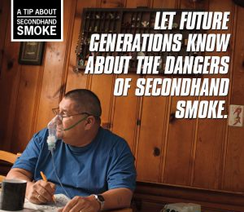
Secondhand Smoke is Harmful
There is no safe amount of
secondhand smoke
Notes:
Let’s move on to second hand smoke which is the result of smoking cigarettes, cigars, and pipes around others. Those who are exposed are inhaling the smoke. Those nontobacco users who are around smokers are more likely to develop lung cancer and heart disease. Among children and babies, secondhand smoke is associated with lung infections, asthma attacks, ear infections, and sudden infant death syndrome (SIDS). Pets exposed to secondhand smoke are also adversely affected.
There is NO SAFE LEVEL of secondhand smoke. Even brief exposure to secondhand smoke is harmful.
Many places have banned smoking due to the dangerous effects of secondhand smoking.

Slide 5
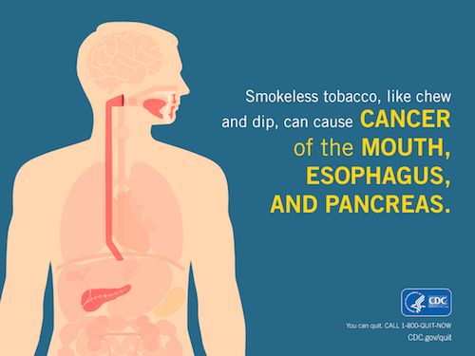
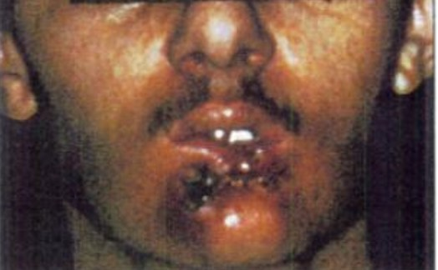
Smokeless Tobacco is Harmful
Fatal mouth cancer in a
28-year-old who dipped
a can a day for 10 years
Notes:
Smokeless tobacco is NOT a safe alternative to smoking. Smokeless tobacco is also known by other names- such as chewing, dipping, spit tobacco. There is also snus (a Swedish form of smokeless tobacco which one does not spit). None of these forms of nonsmoking tobacco are good or safe. Smokeless tobacco contains 28 cancer causing agents. Smokeless tobacco causes oral and pancreatic cancer.
It is associated with gum disease, tooth decay and a precancerous lesion (leukoplakia).
Smokeless tobacco is addictive.
Some people may smoke and use smokeless tobacco leading to higher levels of addiction, and higher risk for cancer.
Swallowing the dip, chew spit tobacco often occurs among users, which is harmful. Swallowing, whether intentional or accidental, can lead to medical problems.

Slide 6
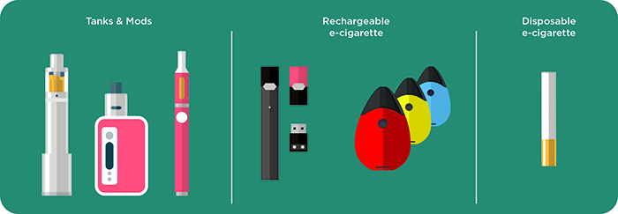
E-Cigarettes and Vaping
E-cigarettes are considered a tobacco product and are addictive.
E-cigarettes are not safe for use.
Vaping and using e-cigarettes to aid with quitting smoking is not a proven cessation method.
Notes:
Electronic Nicotine Delivery System (ENDS)products are also known as e-cigarettes, e-hookahs, e-pipes, and as vaping. You may have heard and seen them around here. They are being touted as harmless and safe; and as a way to quit smoking. None of these statements or myths are true or correct. We do not completely know the full extent of the dangers associated with e-cigarette and e-product use. We do not know exactly what substances are in the electronic products. They have NOT been found to be an effective way to quit smoking. Some e-products have been banned in other countries, and there are restrictions on where they may be used. E-cigs have caused explosions, fires and been banned on planes, ships, and submarines due fire hazards associated with charging these devices.

Slide 7
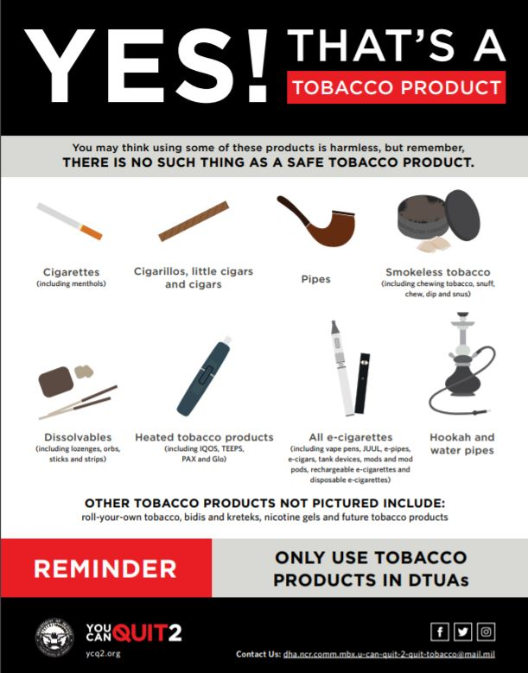
Alternative Tobacco Products are Not Safe
There are no safe types of tobacco products.
Notes:
You may have heard or seen some of the newer forms of tobacco products. None of them are safe forms of tobacco use.
How many know about Hookah? It is a water pipe often used in the middle east and deployed Marines and Sailors are often exposed to them when they are overseas. They contain much more nicotine than cigarettes and higher levels of other hazardous chemicals. Also having a hookah session usually entails staying there for some time- an hour or longer, and the second hand smoke is harmful for you and those who are present. We also know that people share the hookah pipe which may lead to cases of TB and the Hookah shop may not change the water in the hookah pipe on a regular basis. And who knows what someone may have put in the pipe before you?
Another alternative tobacco product is cigars. Cigars have been promoted as cool, sexy, manly, trendy and chic, and for the more affluent in society. Tobacco companies have made a comeback with cigars promoting them as a means to celebrate. Society has adopted them and even began creating lounges and clubs allowing cigar smoking and drinking to occur. However, leaving out the fact that cigar smoke is just as bad as cigarette smoke. The health effects of cigar smoke include increased risk for cancer such as lung and esophageal. Increased risk for diseases such as Chronic Obstructive Pulmonary Disease (COPD), Coronary Heart Disease (CHD), and Aortic Aneurysm. Just like cigarettes, cigars affect your military readiness and should be avoided or quit.

Slide 8
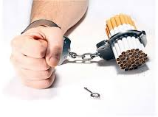
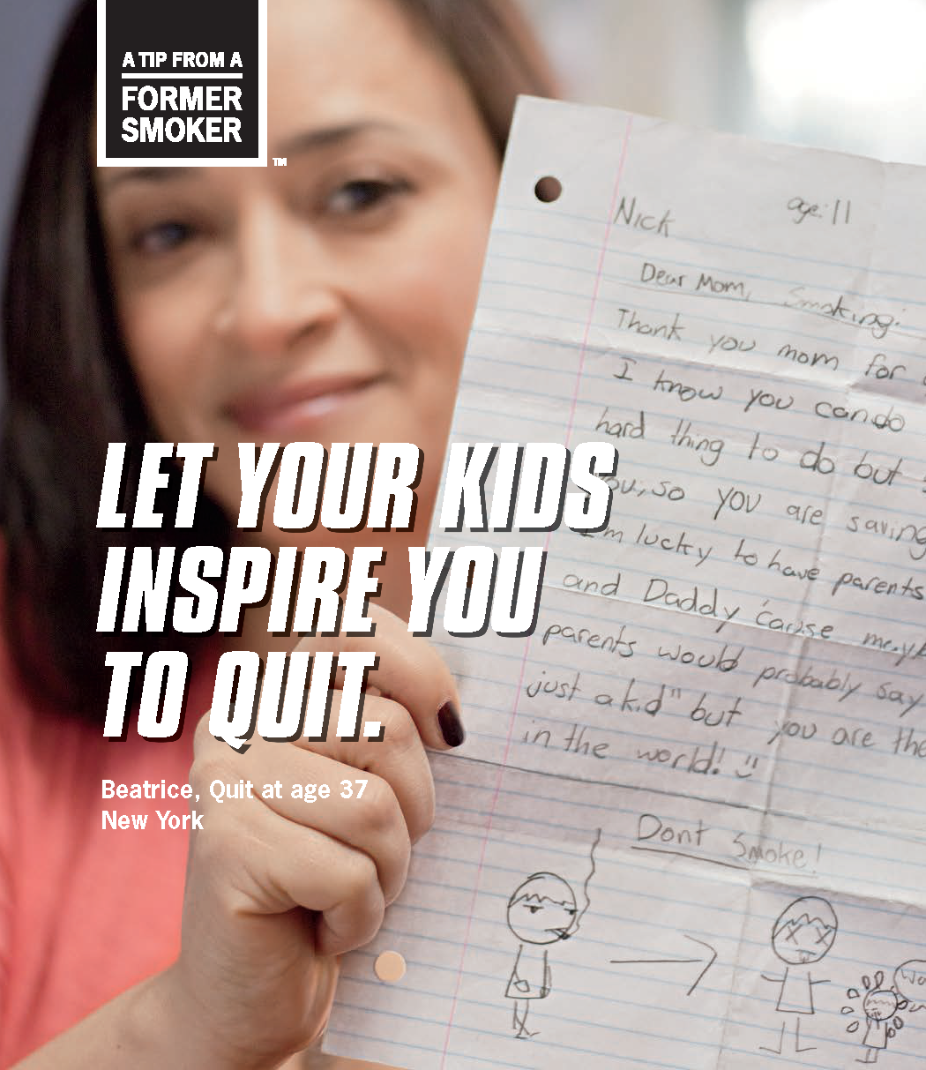
Tobacco Use is Addictive
Repeated use of tobacco products (chew, cigarettes, cigars, dip, electronic, pipes, smokeless) results in nicotine dependence.
Effects of nicotine withdrawal when cutting back or quitting are usually short-lived.
Most tobacco users are interested in quitting.
Often takes several serious quit attempts to be successful.
There are many proven ways to quit, and there are more former smokers than there are current smokers.
Notes:
By using any type of tobacco, whether smoking, smokeless, or vaping, the individual becomes hooked on and addicted to nicotine. Nicotine is powerful and may be as addictive as other problem drugs such as alcohol, cocaine and heroin.
When someone is trying to quit using tobacco, they often experience nicotine withdrawal symptoms, which may include feeling anxious, angry or irritable, have trouble concentrating and sleeping, experience cravings for tobacco and an increased appetite.
There is some Good News-the vast majority of tobacco users are interested in quitting. And there are numerous effective treatments to aid with quitting and staying tobacco free. Quitting is hard and usually takes several serious quit attempts in order to remain tobacco free. Thousands have successfully quit and there are now more ex-smokers in this country than there are smokers.

Slide 9
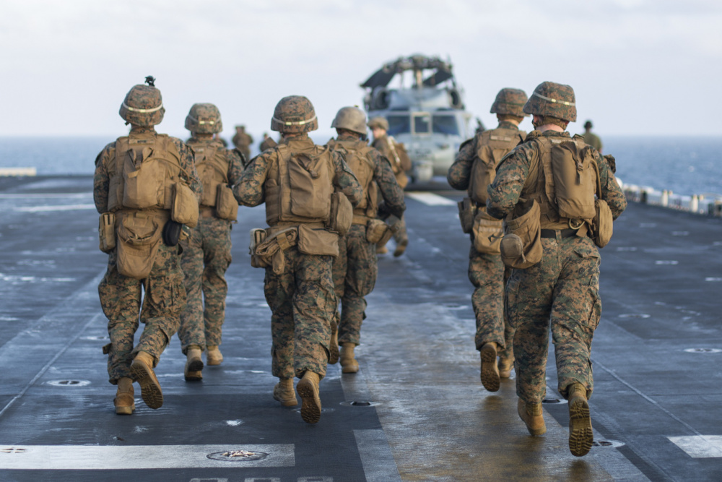

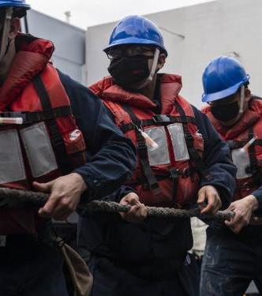
Quitting Tobacco Positively Impacts Mission Readiness
Improves night vision
Increases lung capacity
Increases stamina
Improves fine motor coordination
Decreases injuries and accidents
Boosts ability to manage stress
Notes:
Tobacco use effects everyone one of us. If someone smokes and uses tobacco, it effects them immediately and does short and long term damage. Some of the most notable ways it may harm the individual include-
It affects their night vision and hearing, their breathing, their fine motor coordination, their ability to cope with and manage stress and their stamina. All of these limitations add up to performing poorer at tasks , paying attention, staying focused, working up to speed and excelling at their duties.
We also know that those who use tobacco get hurt more often than non-tobacco users, taking longer to heal and experience more accidents. When someone goes out for a “smoking break” they are absent from their assigned duties, and the non-tobacco users are left back to pull the load and do the work.
All of these add up to affecting the readiness of the Sailor and Marine.
We need all of Navy and Marine Corps Team functioning at their Best. If Sailors, Marines and Civilians are using tobacco, then they are usually not performing at an outstanding level, and this does impact the team's and command's ability to fulfill their mission.

Slide 10
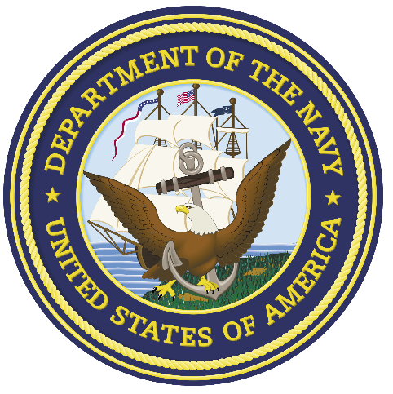
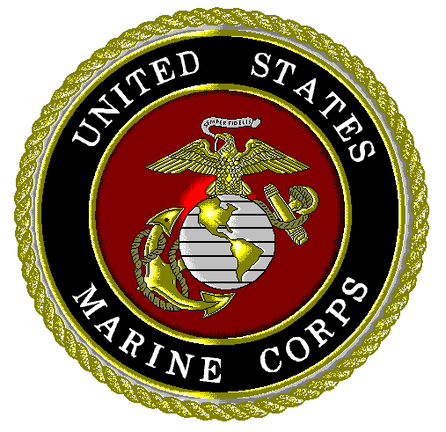
Navy & Marine Corps Tobacco Policy
Tobacco use is prohibited during physical fitness, training and conditioning.
Staff at initial entry and training programs may not use tobacco in the presence of students, recruits, officer candidates and midshipmen.
Tobacco use is prohibited in DON/Government vehicles.
Tobacco may only be used in the designated tobacco use areas.
Must be 21 to purchase tobacco CONUS.
Tobacco product users will have the same number and length of breaks as non-tobacco users.
Notes:
The Navy and Marine Corps has a Tobacco Instruction 5100.13F. Let's review the Policy.
The DON policy states that all forms of tobacco may Only be used in the designated tobacco use areas. This means there is no smoking, vaping or using spit tobacco while walking to our building, or out to the car, or outside the entrance, or inside any military and federal work spaces.
The closest designated tobacco use for our command is located at ______.
The policy states that there are no special smoking breaks. Breaks for tobacco use are not required. If breaks are given, then they are the same for tobacco free individuals as for those who use tobacco.
If there is an issue or a problem with tobacco use, the policy states that the right to a tobacco free space will win out.
Any form of tobacco may Not be used during fitness and physical activity. The Smoking lamp is out.
All staff members- both military and civilian, may not use any tobacco in front of students during recruit, entry and training programs according to the Instruction.
The Navy/Marine Corps Policy says that "a user of tobacco products is not the Navy's vision of a fit war-fighter.“ The Instruction says that the “DON vision is to become tobacco free.”
The Instruction also states the "DON vision is to become tobacco free.“
For additional information the SECNAV Instruction may be reviewed.
You may provide details of your command Tobacco policy/Instruction if there is one.

Slide 11
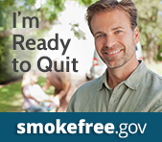
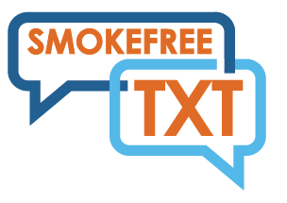

Where to Go for Help
Medical/Dental
MTF Health Promotion Tobacco Cessation Program
Call your state quit line at 1-800-QUITNOW
Web based Cessation Programs
  Navy & Marine Corp Tobacco Free Living
Defense Department You Can Quit 2
Apps
Texting and Chatting Programs
Civilian Healthcare Plan Coverage
Notes:
Congratulations to those who are living a tobacco free lifestyle! Don’t start using any tobacco. Consider encouraging your friends, shipmates, family to quit and support them with the process.
There are many free, effective and easily available locations, resources and professionals to help with quitting tobacco use.
Check with the local Dental and Medical Clinic , Hospital (list them out for your location) and your Primary Care Provider.
The local Hospital/ Branch Health Clinic Health Promotion offers tobacco cessation counseling. (get their phone number, name and point of contact)
Our state has a free Tobacco Cessation Quit Line staffed by trained professionals and coaches. (Check for additional state quitline numbers to call and their hours of operation)
There are many free online cessation programs that help with quitting smoking and smokeless tobacco. Check out the federal government websites www.smokefree.gov, www.cdc.gov and the Navy Marine Corps Public Health Center .
There are 3 good government smoking cessation apps- 2 for adults and one for teens.
If you would like text support for quitting, consider the free text programs from smokefree.gov and ucanquit2.
For civilians, your healthcare plans are all supposed to cover counseling and medications to help with tobacco cessation. Check with your healthcare plan to find out the details of your benefits.

Slide 12
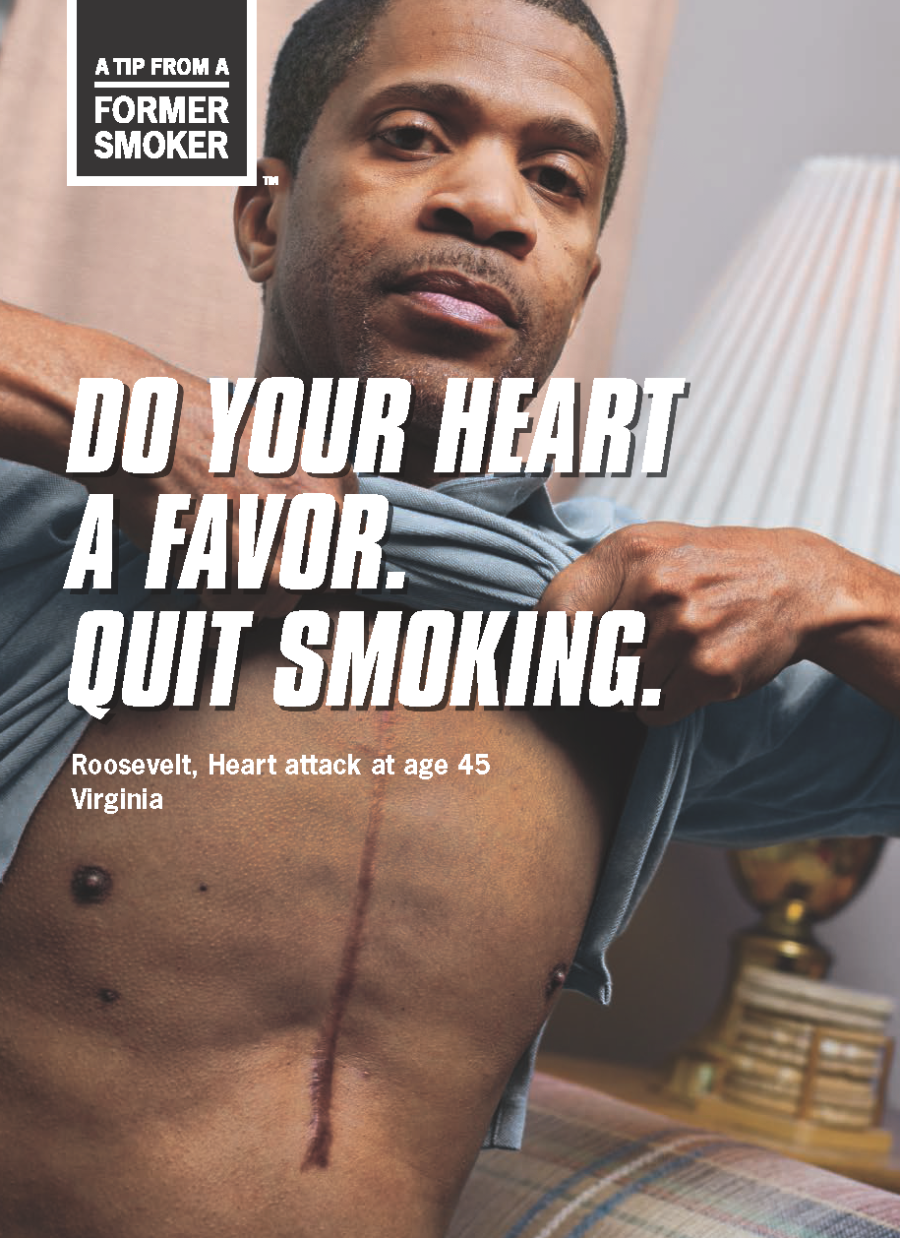
Videos
The Truth about Tobacco
“Cessation Tips”
Roosevelt’s Tip “Younger Smoker’s Think they Aren’t Addicted”
James’ Tip” No, I Won’t Buy You Smokes”

